Slide 1
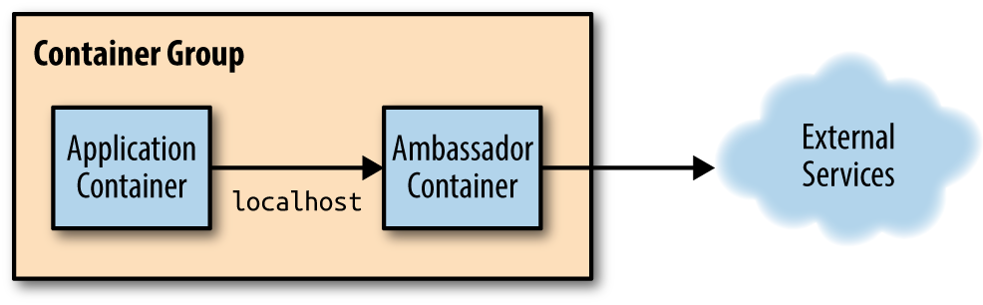
Ambassadors Definition
Where an ambassador container brokers interactions between the application container and the rest of the world. As with other single-node patterns, the two containers are tightly linked in a symbiotic pairing that is scheduled to a single machine.

Slide 2
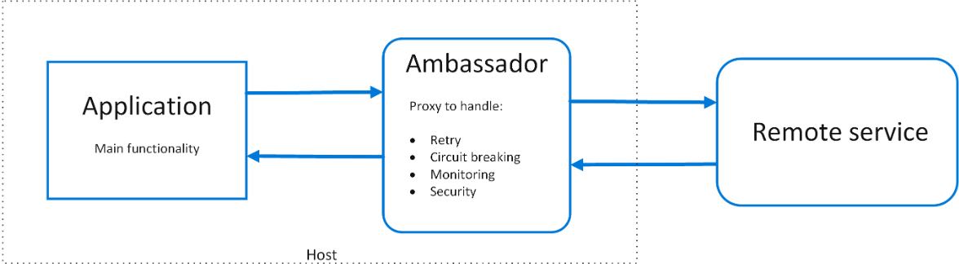
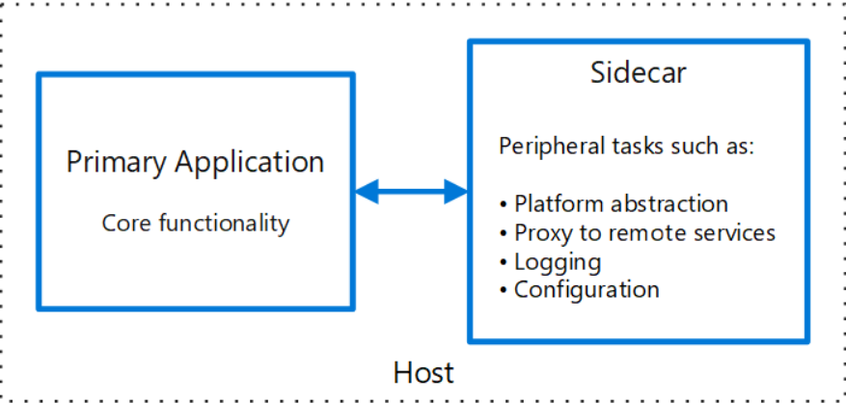
Ambassadors vs Sidecar
https://docs.microsoft.com/en-us/azure/architecture/patterns/ambassador
https://docs.microsoft.com/en-us/azure/architecture/patterns/sidecar

Slide 3
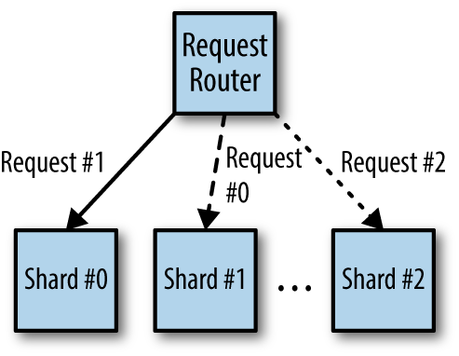
Using an Ambassador to Shard a Service
Sharding splits up the layer into multiple disjoint pieces, each hosted by a separate machine. Once approach is to build all of the sharding logic into the sharded service itself.

Slide 4
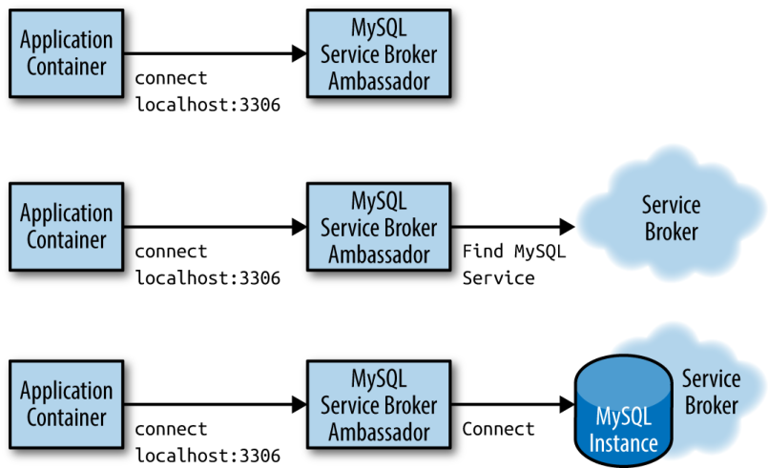
Using an Ambassador for Service Brokering
Building a portable application requires that the application know how to introspect its environment and find the appropriate MySQL service to connect to.This process is called service discovery, and the system that performs this discovery and linking is commonly called a service broker.

Slide 5
Using an Ambassador to Do experimentation or Request Splitting
In many production systems, it is advantageous to be able to perform request splitting, where some fraction of all requests are not serviced by the main production service but rather are redirected to a different implementation of the service. Most often, this is used to perform experiments with new,beta versions of the service to determine if the new version of the software is reliable or comparable in performance to the currently deployed version.
Web
90%
Application container
Ambassador container
10%
Experiment

